Slide 1

Bicycle Infrastructure Recommendations
Katelyn Schreyer
DATA 205
Spring 2021

Slide 2
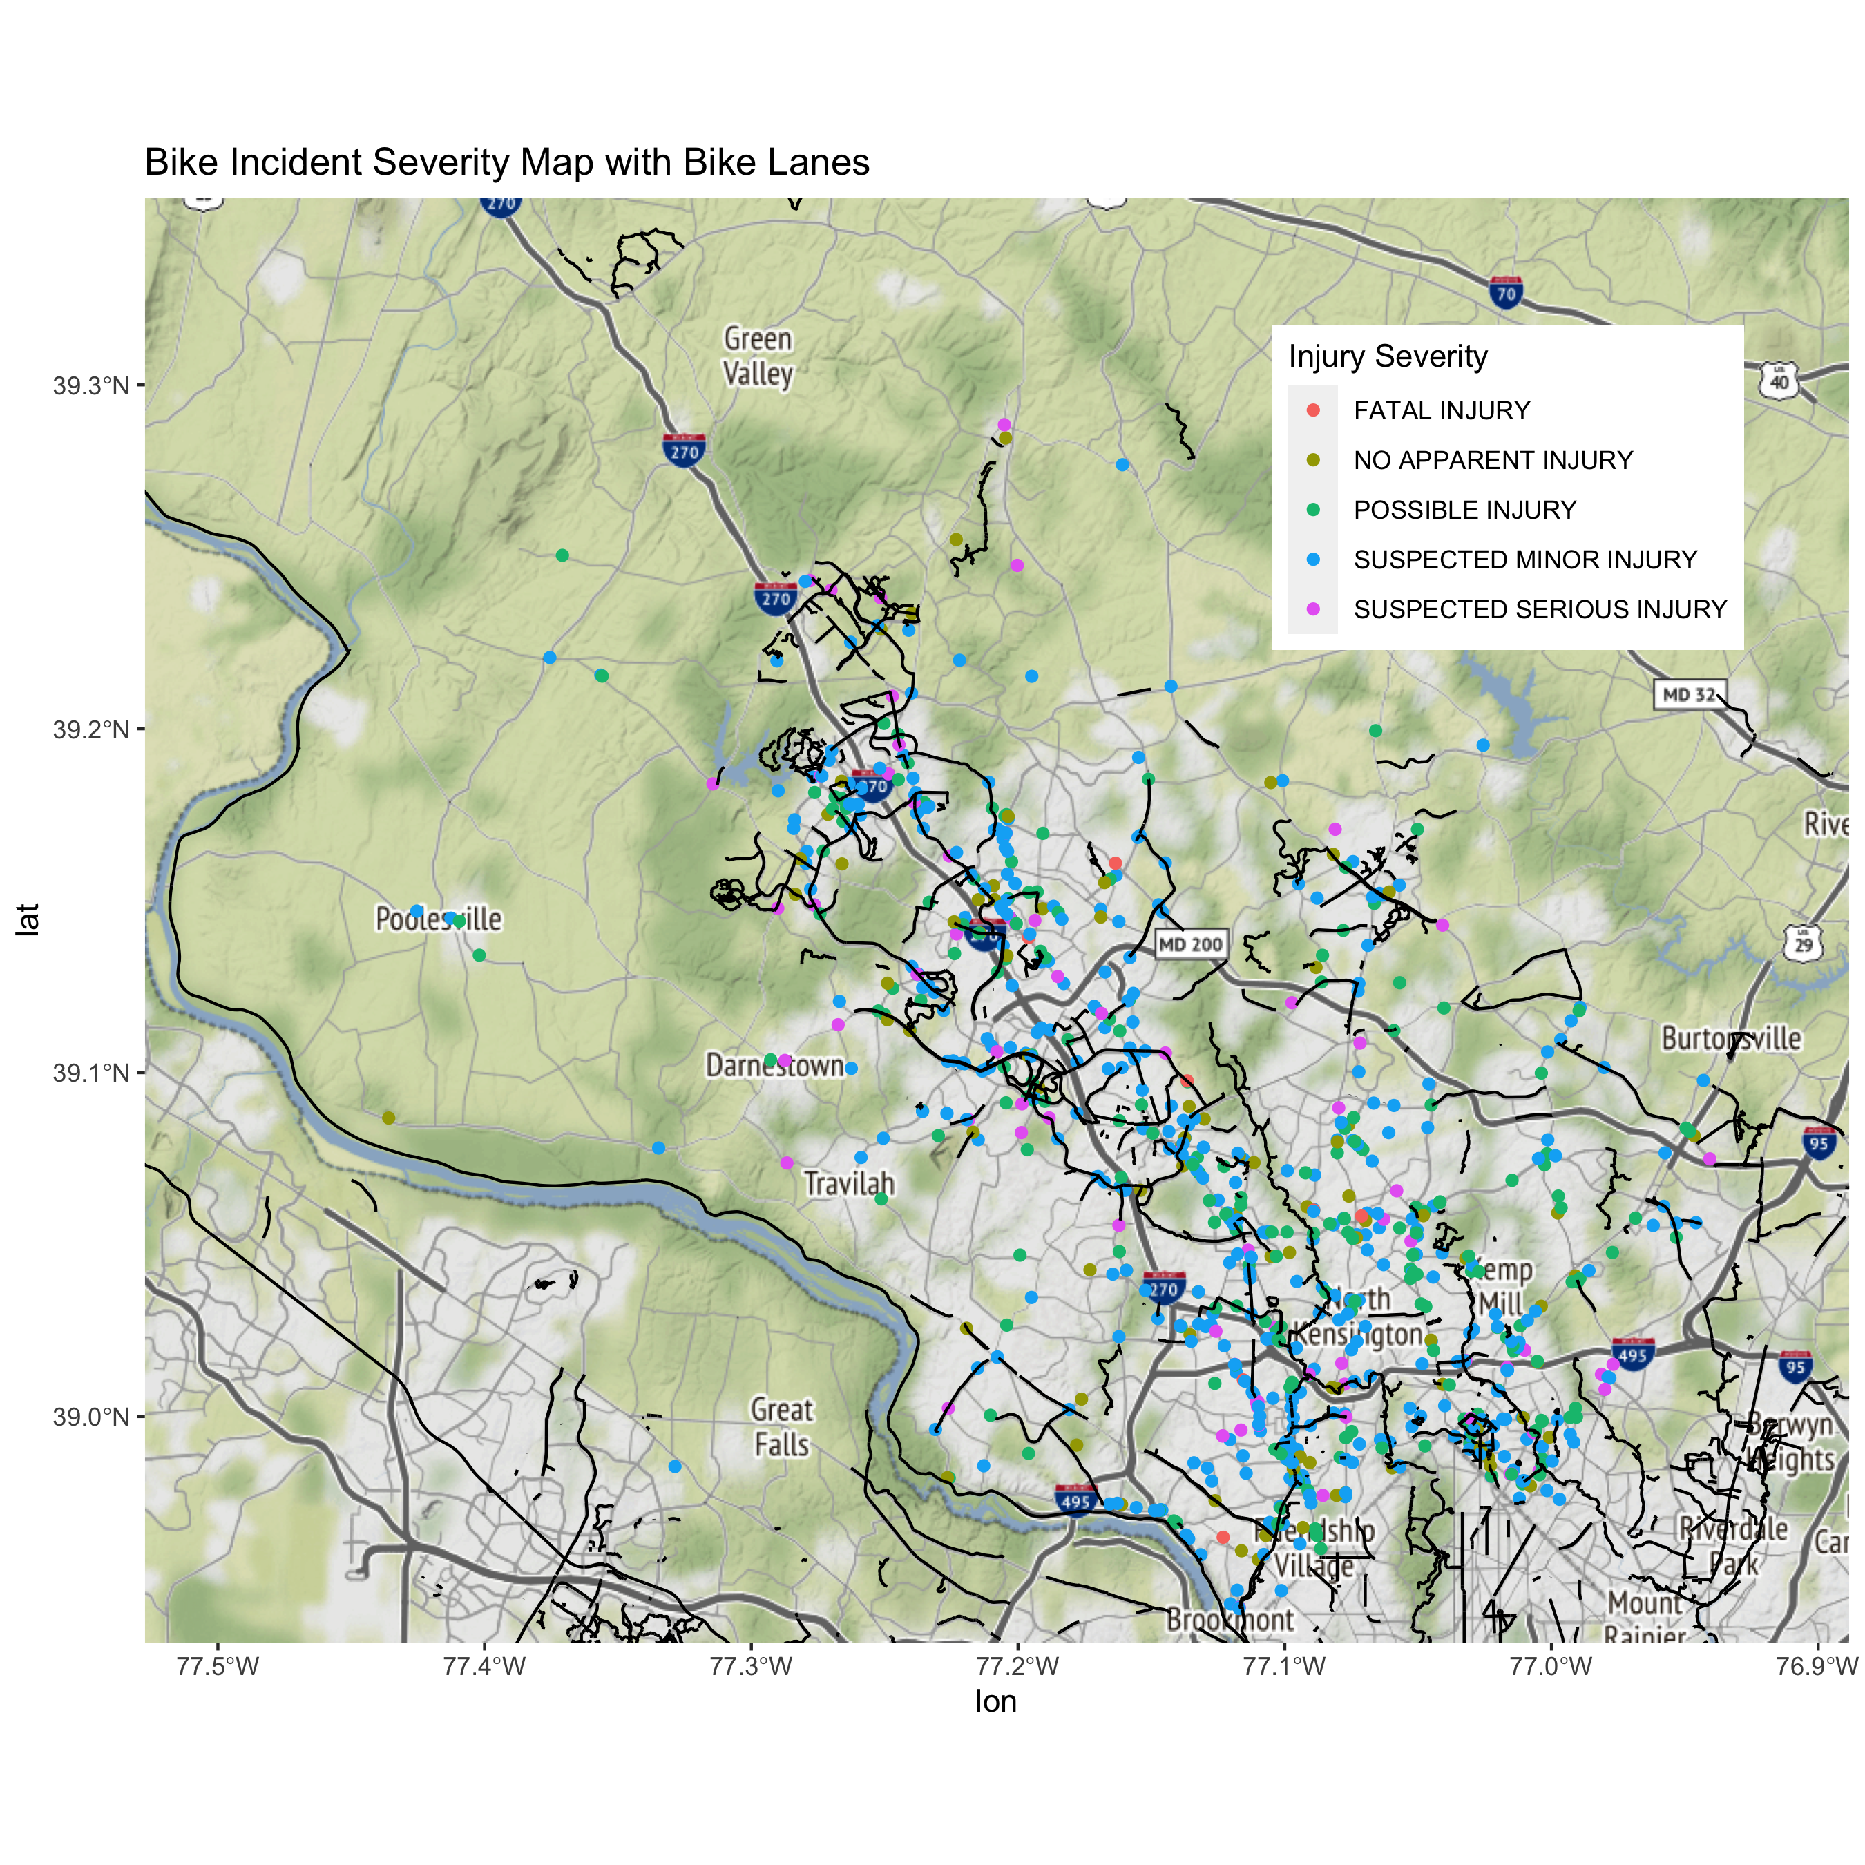
Cycleways

Slide 3
Objectives
Identify roads or road segments with high numbers of bicyclist-involved incidents
Recommend which bicycle infrastructure improvements to prioritize that could prevent the greatest amount of collisions/injuries
The Bicycle Master Plan already provides infrastructure recommendations considering what is feasible and appropriate to the road, but not which should be done first

Slide 4
Datasets
Dataset | Provider | Description | Use for this project
Non-motorist collisions | dataMontgomery | Location, severity, and other details of accidents involving a bicyclist | Identify roads to examine, calculate incident rate
Roadway & Mapping Information | OpenStreetMap | Geospatial database of roads and map tiles | Collect roadway characteristics and tiles for mapping
Bicycle Master Plan | Montgomery Planning | Comprehensive survey of the streets in Montgomery County, including current Level of Traffic Stress (LTS) and bicycle infrastructure | Determine LTS of roadways where incidents occurred, existing bicycle infrastructure, planned bicycle infrastructure

Slide 5
Methods
Compare incident severity to the Level of Traffic Stress (LTS) of the road segment at which they occurred
Calculate bicyclist-incidents-per-mile rate for every street in Montgomery County
Map incident locations and visually inspect the map for street segments or intersections with unusual incident clusters
Inspect high-incident roads or hotspots to see what infrastructure exists, if any, and what has been recommended.

Slide 6
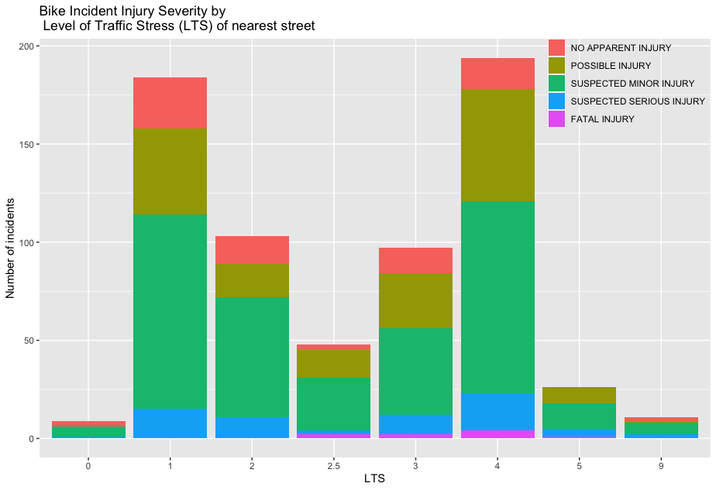
Key Results

Slide 7
Key Results
Visually identified hotspots:
Incident per mile calculations:
Road Name
Old Georgetown Road
Downtown Silver Spring
Little Falls Pkwy – Capital Crescent Trail
Georgia Ave between Ralph Rd and Heathfield Rd (Home Depot/Aspen Manor shopping area)
University Blvd – near Colesville Rd
Road Name | # Reported Incidents | Road Length (miles) | Incidents per mile
DORSET AVENUE | 7 | 1.25 | 5.59
STEDWICK ROAD | 5 | 1.50 | 3.33
FENTON STREET | 4 | 1.25 | 3.21
LITTLE FALLS PKWY | 8 | 2.50 | 3.20
ARDENNES AVENUE | 3 | 0.95 | 3.16

Slide 8
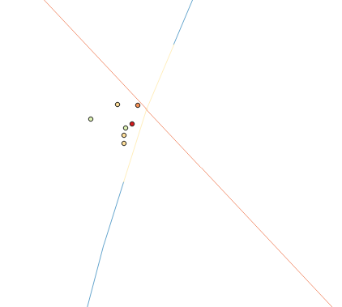
Little Falls Pkwy
7 of 8 incidents occurred at the Capital Crescent Trail crossing; 1 fatal
In 2017, bollards and additional signage was installed, and the number of lanes was reduced around the crossing
In 2020, a speed table crosswalk was completed; no incidents reported since
Little Falls Pkwy
Capital Crescent Trail
Recommendation: No further action

Slide 9
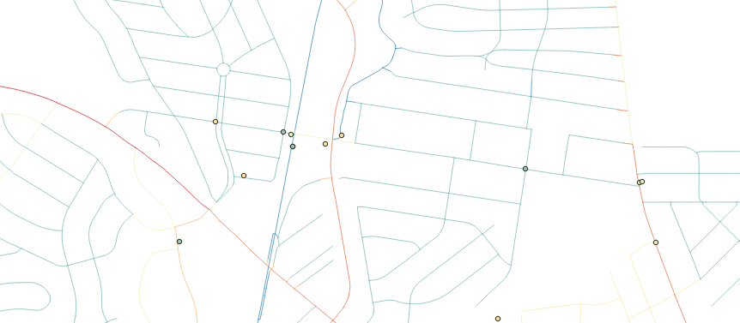
Dorset Ave
Capital Crescent Trail
1.25 miles
5.59 incidents per mile
No serious injuries
Connects Wisconsin Ave and River Road
Provides access to Capital Crescent Trail
Potentially very high bike traffic?
Wisconsin Ave
River Rd
Dorset Ave
Recommendation: Add painted bike lane (low priority)

Slide 10
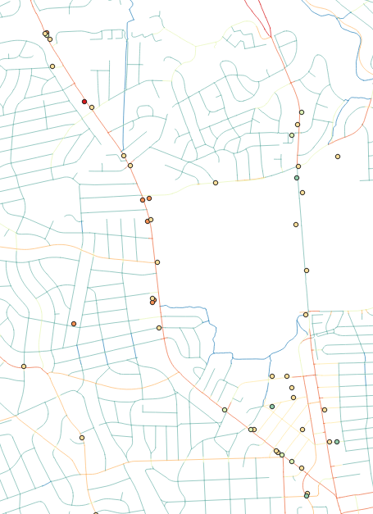

Old Georgetown Rd
I-495
Cedar Rd
Separated Bike Lane (highlighted) added from the Beltway to Cedar Rd in 2020 following a fatal collision in 2019
Cedar Road to Wisconsin Ave still has a high incident rate
Wisconsin Ave
Old Georgetown Rd
Recommendation: Extend separated bike lane to Wisconsin Ave (or to the Bethesda Trolley Trail)

Slide 11
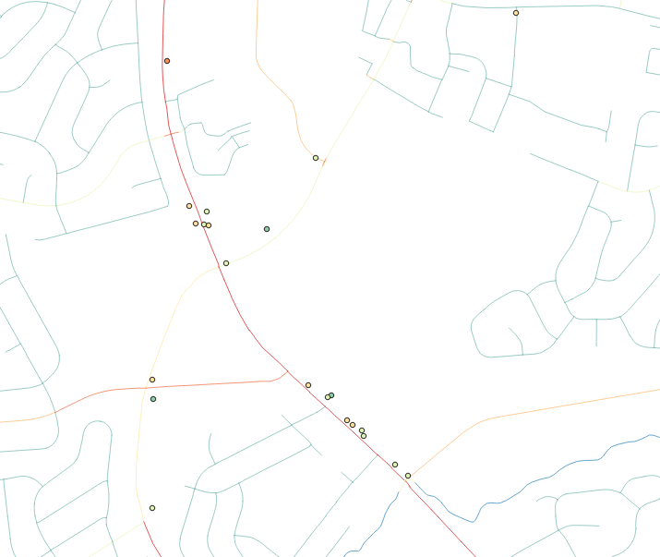
Georgia Ave (Ralph Rd to Heathfield Rd)
Collision Hotspots around the entrance to Home Depot and the Aspen Manor Shopping Center
Connecticut Ave
Home Depot
Aspen Manor
Shopping Center
Georgia Ave
Recommendation: Add separated bike lane

Slide 12
Thank you!
dataMontgomery
for making data available to the public and building a culture of data-aware and data-involved citizens
Montgomery Planning
for the extensive work creating the Bicycle Master Plan
for championing interventions that have saved lives
Montgomery College Professors
Michael Iapalucci
Rachel Saidi
Abdirisak Mohamed

